Slide 1

Thermomechanical simulation
of Nickel-based Super Alloy(Inconel 718)
using Abaqus
Final report
朱镇
January 3, 2023

Slide 2


1
2
3
Part one
Part two
Part three
Background
and Physics
Properties
Result

Slide 3
1
Part one
Background and Physics

Slide 4
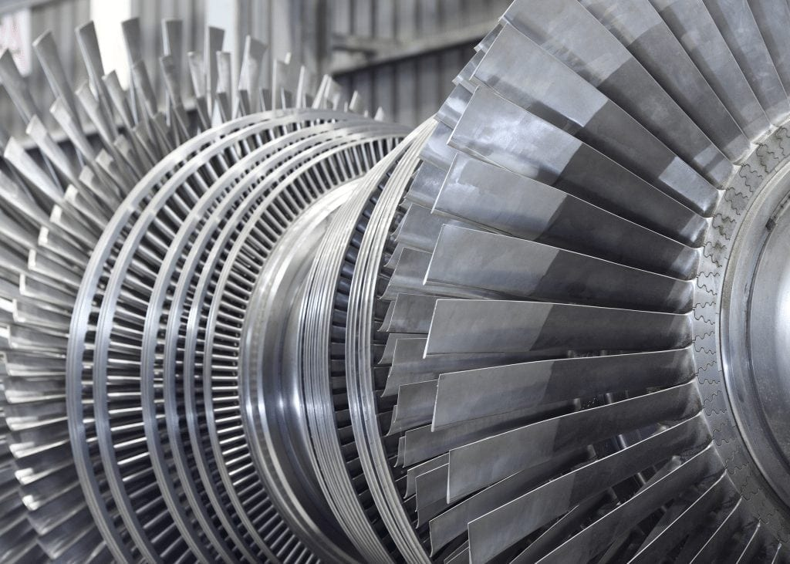
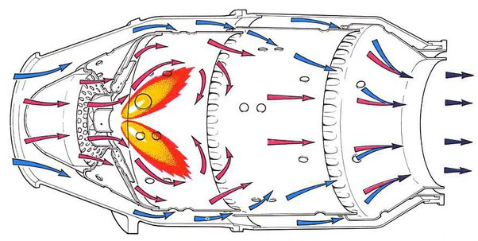
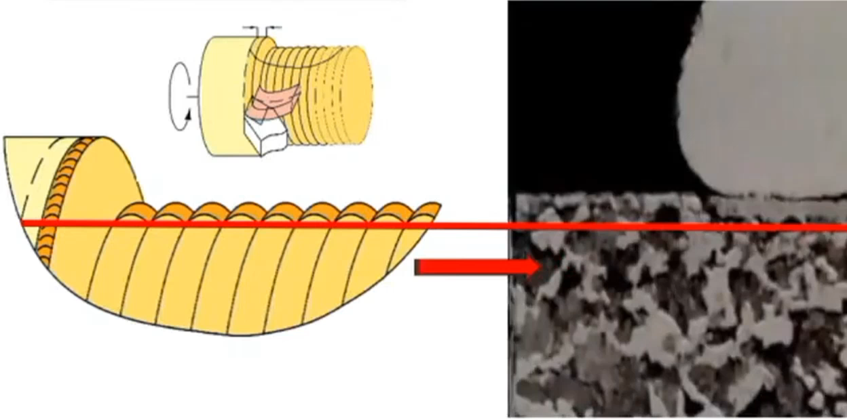
Background
Inconel 718 nickel-based alloy (GH4169 in GB) -- Widely used in Aerospace, Nuclear and Marine industries
Advantages^{[1]}:
High Stiffness and Strength at high temperature(850 °C)
High Dynamic Shear Strength
Extremely low Reactivity in highly corrosive environment
Examples: Turbine Blades and Combustion Chamber in turbine engine
Poor machinability^{[1]}:
Adhere with tool——built up edge(积屑瘤)
Strain hardening——harder for next cut
Low thermal conductivity——high temperature in cutting zone
Simulation
Proper Cutting Parameters and Tools
[1] Rinaldi S, Imbrogno S, Rotella G, et al. Physics based modeling of machining Inconel 718 to predict surface integrity modification[J]. Procedia CIRP, 2019, 82: 350-355.
Notes:
Label “difficult to machine”, different, not necessarily difficult, evaluate differences, material properties, how nickel interacts with a cutting edge, cutting forces, chip
morphology, surface integrity, deform due to strain, stress appears in the structure, shows a tendancy to harden,experimental investigation, expensive and time-consuming

Slide 5
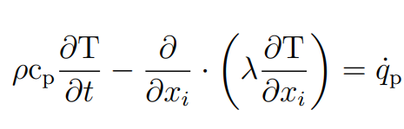
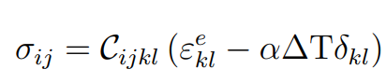
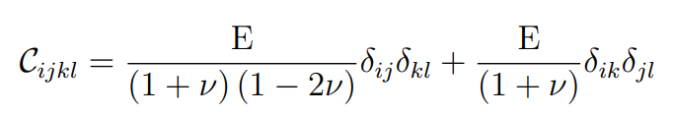
Physics
1. Workpiece
2. Tool
3. Contact
thermal and mechanical model
Thermomechanical coupling modeling^{[2]} :
Specific heat capacity c_{p}
Thermal conductivity λ
Thermal expansion α
Temperature dependent
1.1 Workpiece thermal model: The first law of thermodynamics
1.2 Workpiece mechanical model:
Elastic model: Hooke’s law
Young’s modulus E
Possion’s ratio ν
Temperature dependent
[2] Bedzra R. Finite element simulation of two dimensional orthogonal cutting process and comparison with experiments[D]. GER: RWTH Aachen University, 2013.
Notes:
Investigate mechanical and thermal variables related to surface integrity

Slide 6
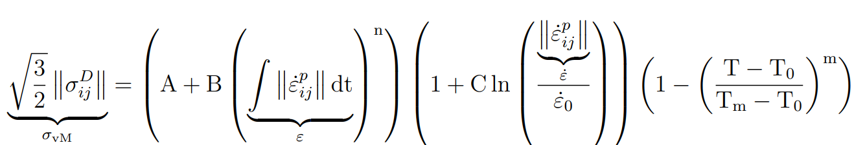
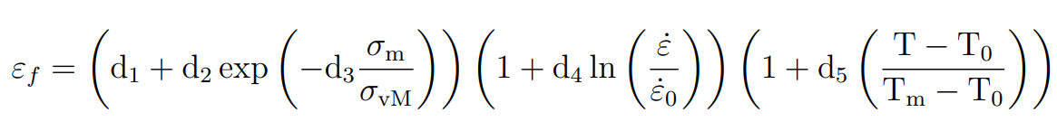
Physics
1. Workpiece
2. Tool
3. Contact
thermal and mechanical model
Thermomechanical coupling modeling^{[2]} :
1.2 Workpiece mechanical model:
Plastic model: Johnson-Cook plasticity model
Coefficients A, B, C, m, n
Reference strain rate
Reference temperature T₀
Melting temperature T_{m}
Material separation (chip formation) model: Johnson-Cook damage model
Material dependent parameters d₁, d₂, d₃, d₄, d₅
Reference temperature T₀
Melting temperature T_{m}
Reference strain rate
Stress triaxiality on fracture
Strain rate
Temperature
[2] Bedzra R. Finite element simulation of two dimensional orthogonal cutting process and comparison with experiments[D]. GER: RWTH Aachen University, 2013.
Notes:
Investigate mechanical and thermal variables related to surface integrity

Slide 7
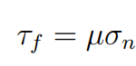
Physics
1. Workpiece
2. Tool
3. Contact
thermal and mechanical model
Thermomechanical coupling modeling^{[2]} :
2 Tool mechanical and thermal model:
Elastic model: Hooke’s law
Thermal model: The first law of thermodynamics
3.1 Contact mechanical model: Coulomb’s friction law
Friction coefficient μ
3.2 Contact thermal model:
Contact between tool and chip is thermally perfect
Boundaries are assumed to be at room temperature(20℃)
Heat loss due to convection and radiation to surroundings is not taken into account
Notes:
Investigate mechanical and thermal variables related to surface integrity

Slide 8
2
Part two
Properties

Slide 9
Worpiece properties
1.1 Workpiece dimension
1.2 Workpiece thermal properties
Notes:
J–C material constitutive model for Inconel 718

Slide 10
Workpiece properties
1.3 Workpiece mechanical properties
Elastic:
Plastic:
Material seperation:
Stress triaxiality on fracture
Strain rate
Temperature
Notes:
J–C material constitutive model for Inconel 718

Slide 11
Tool and contact properties
2.1 Tool dimension:
2.2 Tool thermal properties:
α(10⁻⁶/℃) = 540
3.1 Contact friction coefficient:
μ = 0.5
Notes:
J–C material constitutive model for Inconel 718

Slide 12
3
Part three
Result

Slide 13
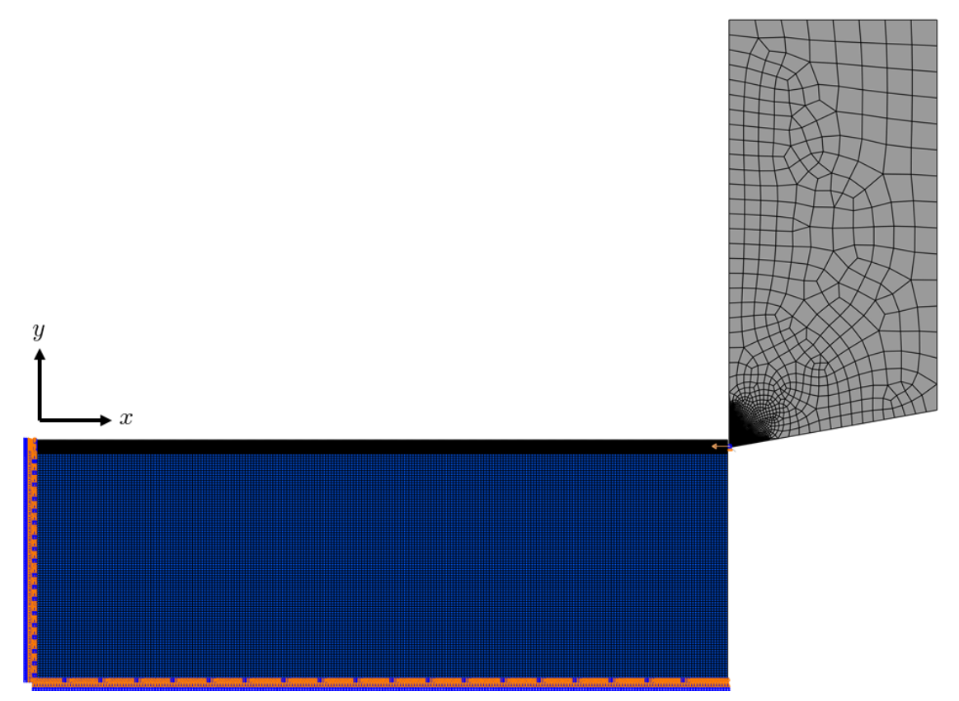
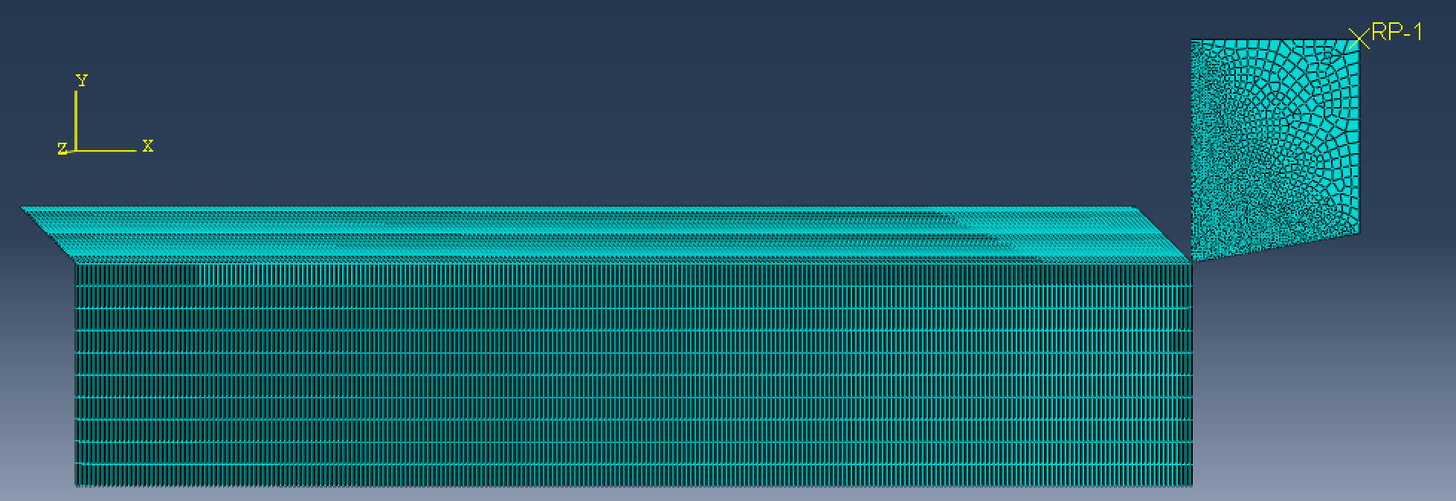
Simulation Result
Different cutting speed: 20m/min, 40m/min, 80m/min
1. Cutting force and feed force
2. Temperature
3. Chip thickness
2mm
0.5mm
5mm
2mm
Notes:
J–C material constitutive model for Inconel 718

Slide 14
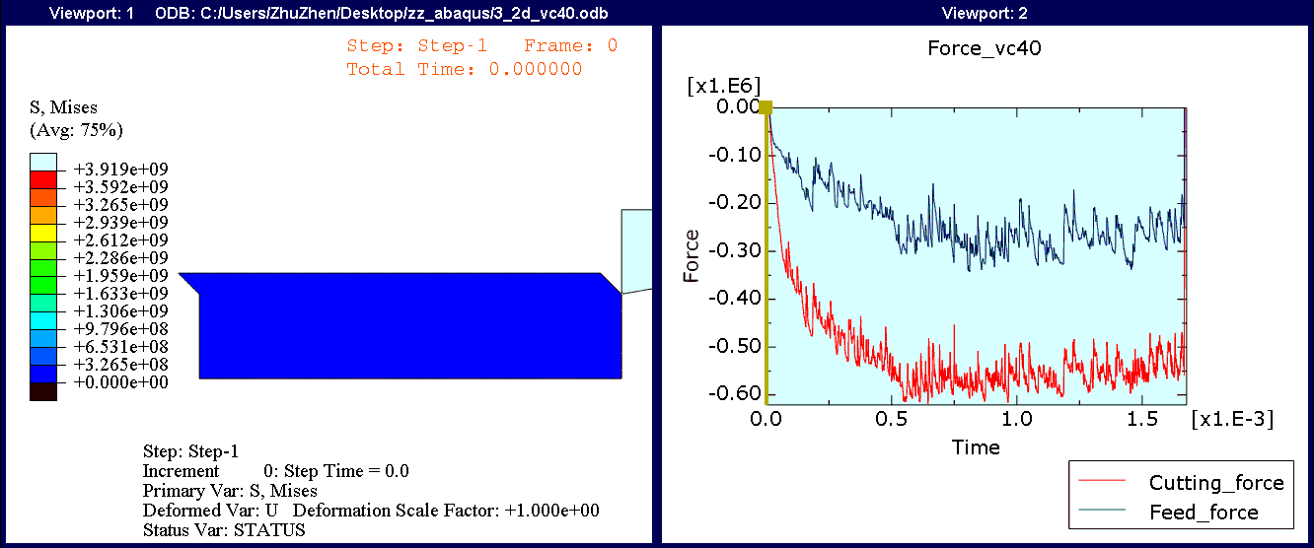
Force
Cutting condition: 40m/min
Cutting force
Feed force
Notes:
J–C material constitutive model for Inconel 718

Slide 15
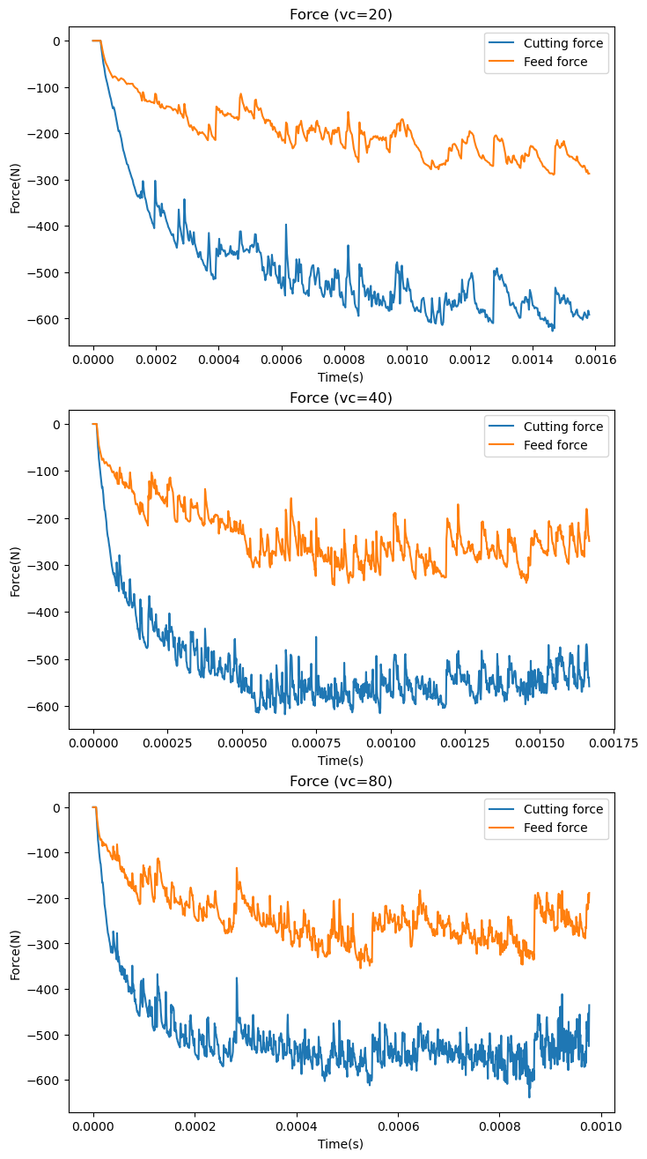
Force
Table 1. My simulation result of average cutting force and feed force
Table 2. Reference experiment and simulation result of average cutting force and feed force
Discrepency:
Two times difference
Insufficient data
Force scale (10^3)
Notes:
J–C material constitutive model for Inconel 718

Slide 16
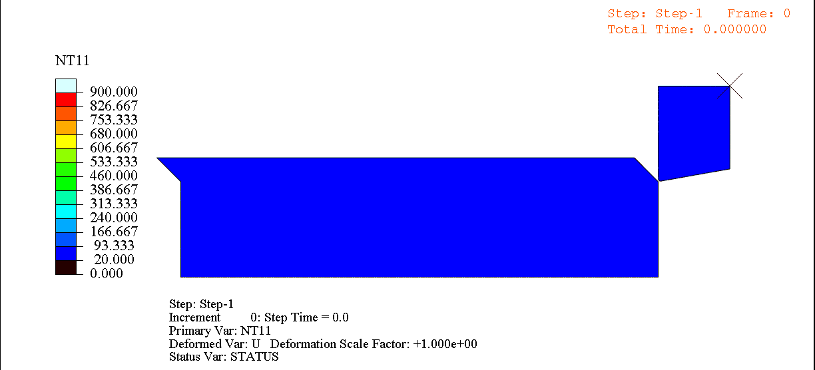
Temperature
Notes:
J–C material constitutive model for Inconel 718

Slide 17
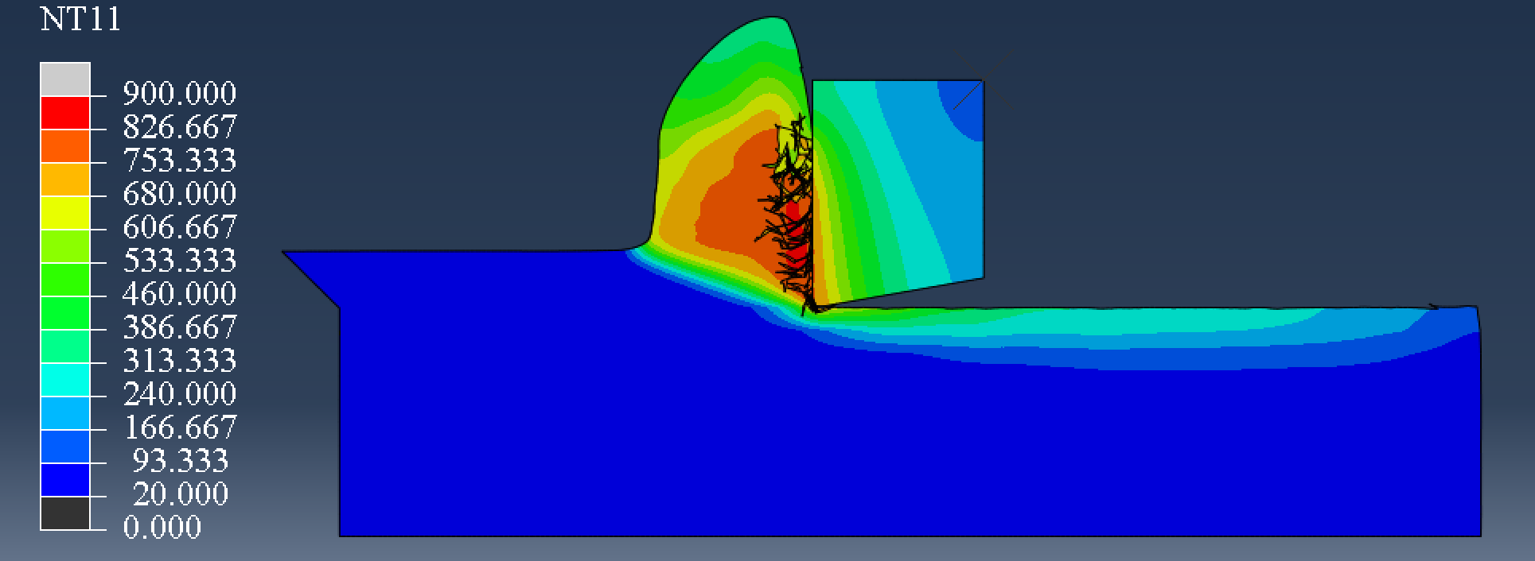
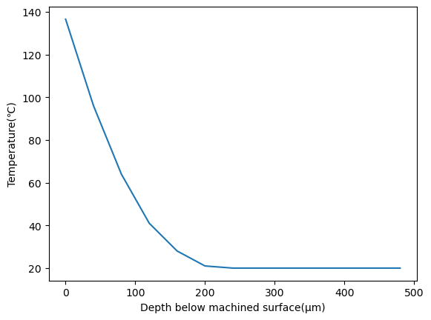
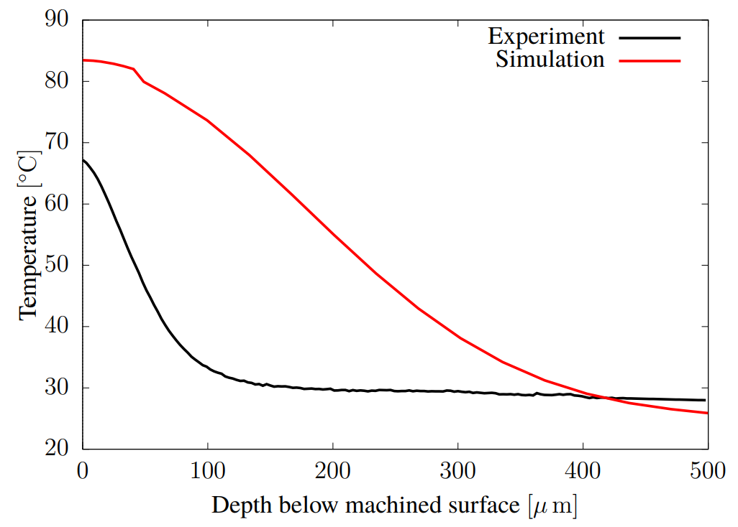
Temperature
A distance of 1 mm behind the tool edge
A distance of 3.5 mm behind the tool edge
Notes:
J–C material constitutive model for Inconel 718

Slide 18
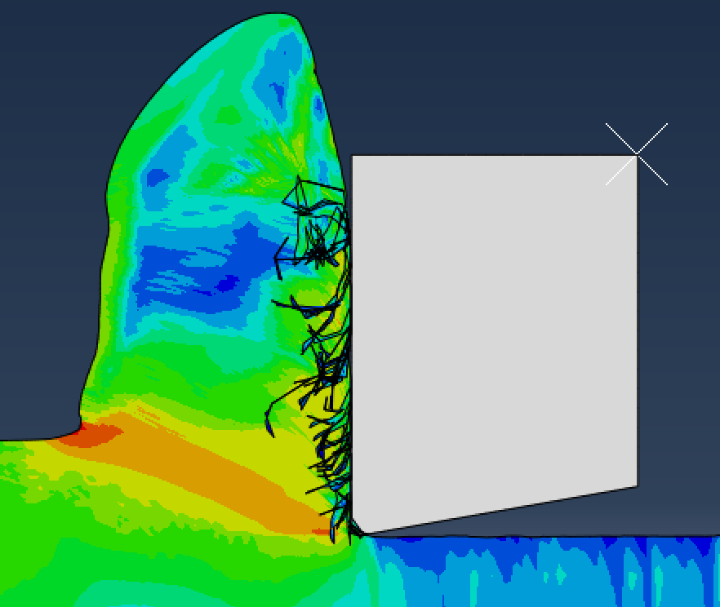
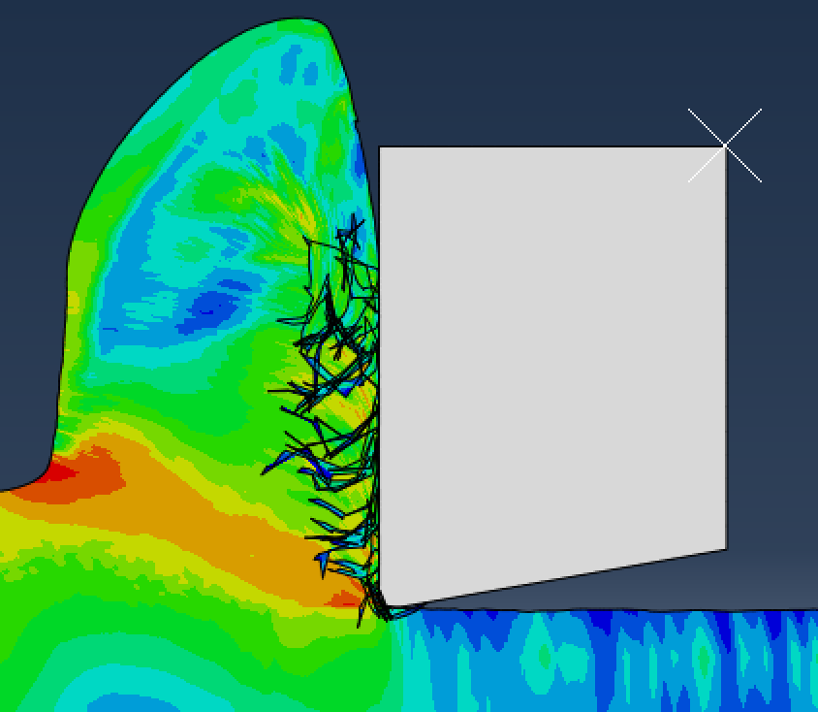
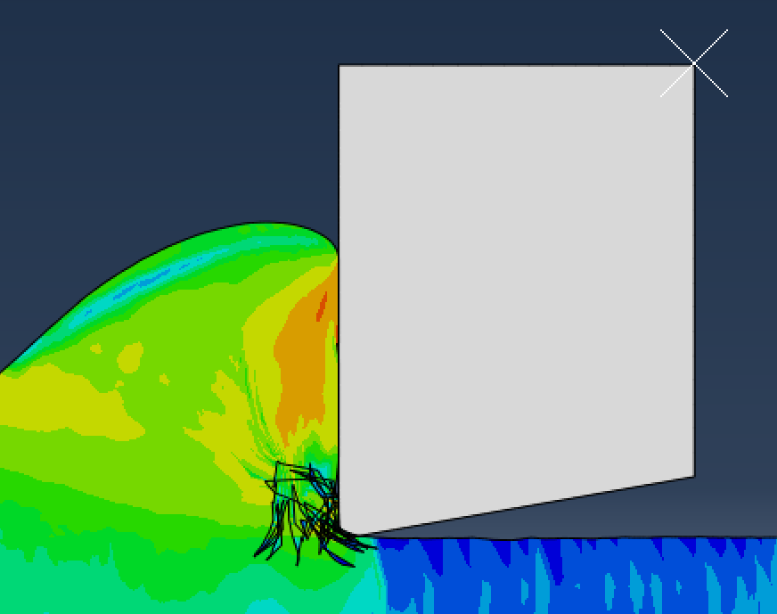
Chip morphology
Vc=20m/min
Vc=40m/min
Vc=80m/min
Conclusion: Continuous chip
Notes:
J–C material constitutive model for Inconel 718

Slide 19
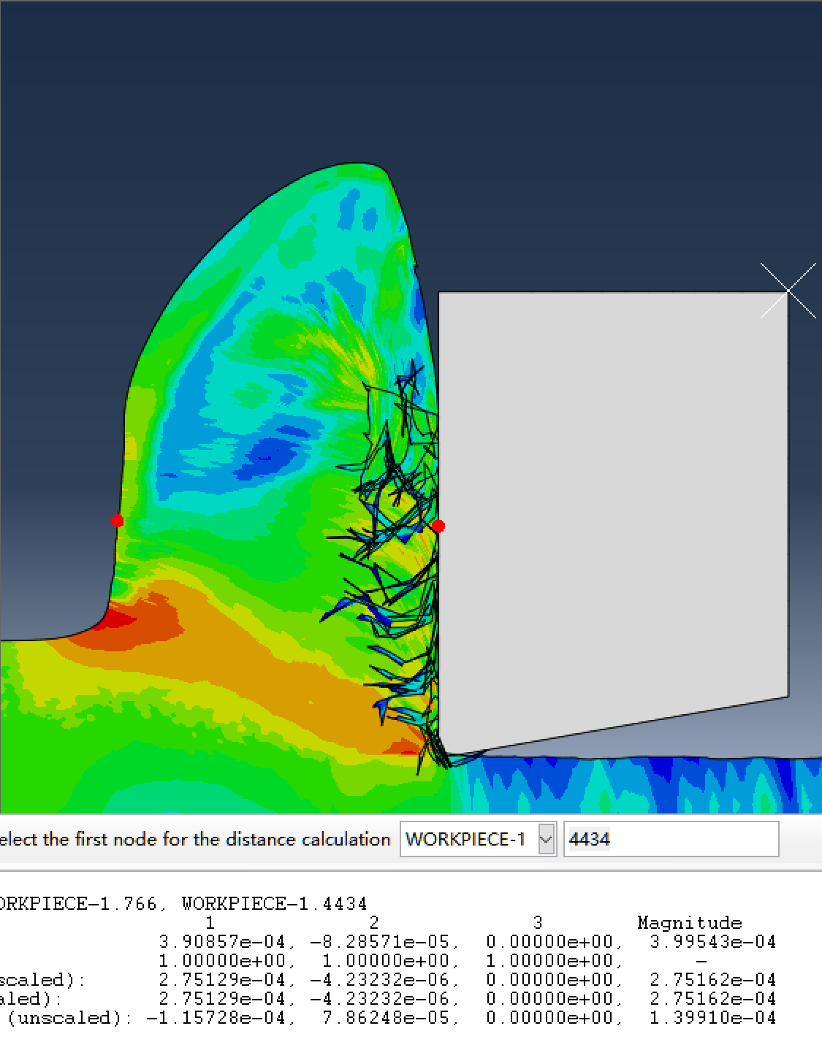
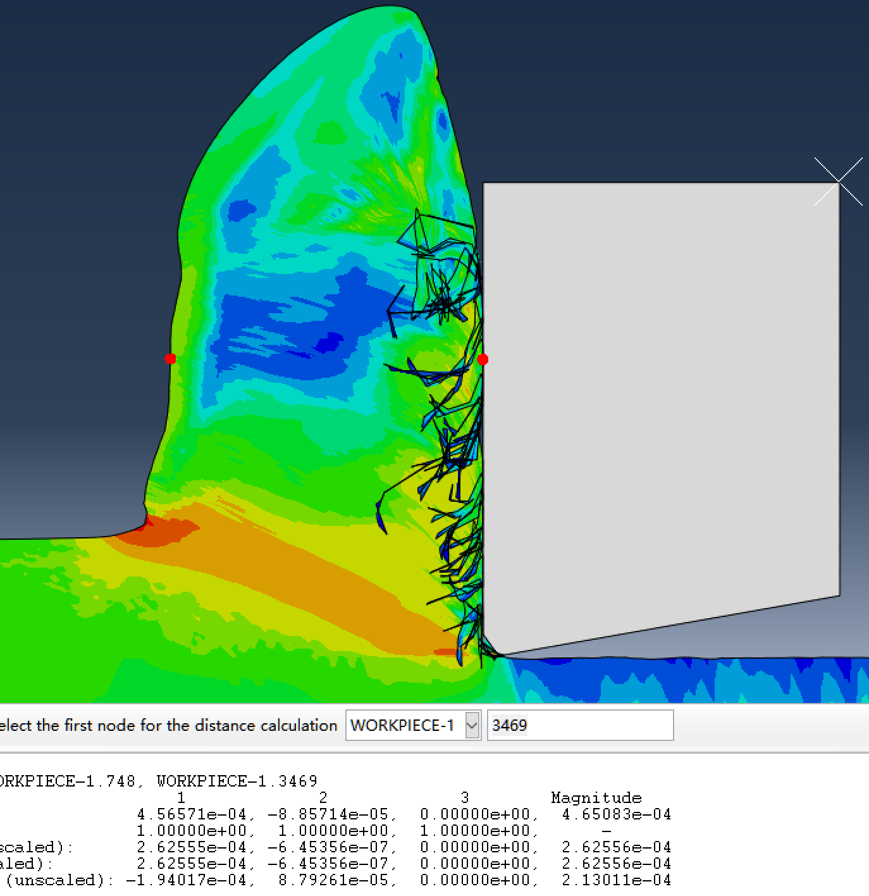
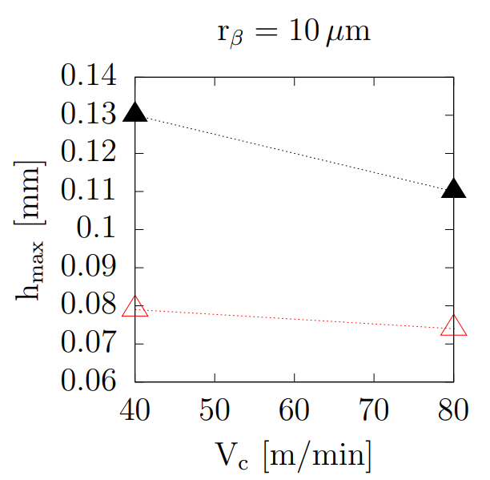
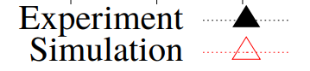
Chip thinkness
Vc=40m/min 0.39mm
Vc=80m/min 0.46mm
Reference
0.08mm
Discrepancy:
Different model
Notes:
J–C material constitutive model for Inconel 718

Slide 20

Thanks

